Slide 1


Prepared by:
Bushen Raaj Y
CONFIDENTIAL: The information in this document belongs to Boston Institute of Analytics LLC. Any unauthorized sharing of this material is prohibited and subject to legal action under breach of IP and confidentiality clauses.

Slide 2


FRAUD DETECTION INTELLIGENCE SYSTEM
Machine Learning Solution for Real-Time Fraud Detection for Mobile Financial Transactions
This project aims to enhance the accuracy of detecting fraud in mobile financial transactions. By leveraging machine learning techniques, the system predicts fraudulent transactions with high precision and recall. The objective is to develop a robust, end-to-end fraud detection model that supports real-time risk assessment and reduces financial losses.

Slide 3

Agenda
Problem Statement | Solution Overview
Dataset Overview | System Architecture
Data Preprocessing & Feature Engineering | Model Development & Evaluation
Streamlit Application Demonstration | Transaction Simulation & Fraud Detection Output
Power BI Dashboard & Business Insights | Financial Impact & Conclusion
1
2
3
4
5
6
7
8
9
10

Slide 4

PROBLEM STATEMENT

Slide 5

Financial Fraud Risks in Mobile Financial Transactions
Mobile and digital financial transactions are increasingly targeted by fraudulent activities, posing serious risks to individuals, businesses, and financial institutions. As transaction volumes grow, detecting fraud in real time has become critical to minimizing financial losses and maintaining trust in digital payment systems.
Challenges in Traditional Fraud Detection
Manual and rule-based fraud detection methods are time-consuming and error-prone.
Static rules fail to adapt to evolving and sophisticated fraud patterns.
Highly imbalanced transaction data makes fraud detection more complex.
Delayed detection leads to irreversible financial losses and customer dissatisfaction.
Role of Machine Learning in Fraud Detection
Machine learning enables the identification of complex and hidden fraud patterns by analyzing transaction behavior, balance movements, and historical trends. ML-driven systems can continuously learn from new data, improving detection accuracy and enabling real-time fraud prevention.

Slide 6
Project Goal
The goal of this project is to develop a robust machine learning-based fraud detection system capable of accurately distinguishing fraudulent transactions from legitimate ones in real time, thereby improving security, reducing financial losses, and supporting data-driven fraud prevention.
Key Outcomes
Security Improvement
Protect users from unauthorized mobile financial transactions.
Financial Loss Reduction
Minimize the impact of fraudulent activities on business revenue.
Fraud Insights
Identify critical patterns and factors contributing to transaction fraud.
This project addresses the growing challenge of fraud in mobile financial transactions by leveraging machine learning to enable accurate, real-time fraud detection and reduce financial losses.

Slide 7

SOLUTION OVERVIEW

Slide 8

Machine Learning–Driven Fraud Detection System
To address the growing risks of fraud in mobile financial transactions, this project implements an end-to-end machine learning–based fraud detection solution designed for accuracy, scalability, and real-time decision-making.
Proposed Solution Approach
Analyze historical mobile financial transaction data to understand fraud patterns.
Apply data preprocessing and feature engineering to capture transaction behavior and balance anomalies.
Train and evaluate multiple machine learning models to accurately classify transactions as fraudulent or legitimate.
Focus on recall and precision to minimize missed fraud cases while reducing false alerts.
System Capabilities
Real-Time Fraud Detection Instantly evaluates transactions and assigns fraud risk scores.
Adaptive Learning Learns complex and evolving fraud patterns beyond static rule-based systems.
Business-Oriented Insights Translates model predictions into financial impact and risk-based actions.

Slide 9
Key Outcomes
Improved Fraud Detection Accuracy Enhanced identification of fraudulent transactions using ML models.
Reduced Financial Loss Early detection prevents high-cost fraudulent activities.
Actionable Fraud Intelligence Supports informed decision-making through dashboards and analytics.
The solution leverages machine learning to provide accurate, real-time fraud detection for mobile financial transactions while delivering actionable business insights.

Slide 10

Dataset Overview

Slide 11





Understanding the Transaction Dataset
Key metadata for fraud model development
Dataset file: modified_dataset.csv containing historical mobile financial transaction data with both legitimate and fraudulent records.
Key transaction fields: amount, transaction type, step-based timestamp, sender and receiver balances, old and new balance values.
Target variable:
isfraud (0 = Legitimate transaction, 1 = Fraudulent transaction).
Dataset significance: realistic representation enabling model training, robust evaluation, and business insights for fraud prevention.
File name and content scope preserved exactly.
List of important features included for modeling.
Binary label definition for supervised learning.
Why the dataset matters for fraud detection efforts.
This dataset enables machine learning models to learn transaction behavior and accurately distinguish fraudulent activities from legitimate mobile financial transactions.

Slide 12
System Architecture

Slide 13
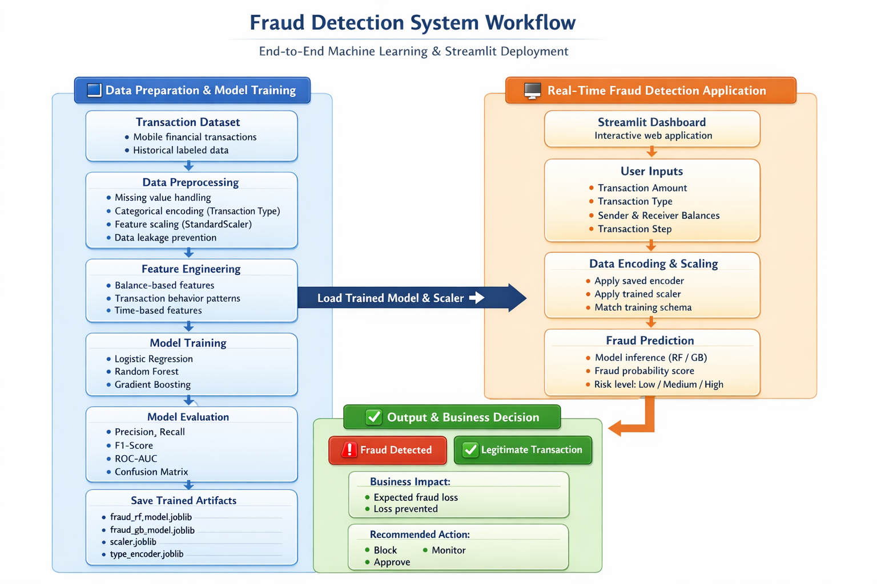

Slide 14
End-to-End Fraud Detection Workflow
From transaction ingestion to real-time decisions and dashboard insights
Transaction Data Source
historical and real-time mobile financial transactions as primary input.
Data Preprocessing and Feature Engineering
cleansing, encoding, scaling, and deriving balance-based features to capture transaction behavior.
Machine Learning Models
trained models such as Logistic Regression, Random Forest, and Gradient Boosting to predict fraud probability.
Real-Time Inference Layer
saved model artifacts, encoders, scalers, and a prediction engine for live transaction scoring.
Output and Decision Layer
fraud classification, risk-based actions (block, monitor, approve), and business insights via dashboards.

Slide 15

Data Preprocessing & Feature Engineering

Slide 16





Prepare Data for Reliable Modeling
Key preprocessing and feature-engineering steps to improve model performance
Cleanse data to handle missing values and anomalies before modeling.
Impute or remove gaps; fix outliers and inconsistent records.
Encode categorical variables and scale numerical features for model compatibility.
One-hot, label encoding; normalization or standardization.
Derive balance-based features using old and new account balances to detect abnormal fund movements.
Create delta, ratio, and rolling metrics from balances.
Address class imbalance through appropriate sampling or algorithmic strategies to improve model learning.
Use oversampling, class-weighted models.

Slide 17
Model Development & Evaluation

Slide 18
Improving Fraud Detection with Machine Learning Models
Candidate models: Logistic Regression, Random Forest, and Gradient Boosting evaluated for fraud prediction performance.
Compared models for fraud prediction performance
1
Confusion matrix used to analyze True Positives, True Negatives, False Positives, and False Negatives, with a focus on minimizing false negatives.
Use confusion matrix to minimize false negatives
2
Models and metrics focused on maximizing recall while protecting customer experience
Evaluation metrics prioritized: Recall, Precision, F1-Score, and ROC-AUC with emphasis on maximizing recall to reduce missed fraud cases.
Prioritize recall to reduce missed fraud
3
Model behavior insight: tree-based models captured complex fraud patterns and improved recall while controlling false positives to protect customer experience.
Tree-based models improved recall and controlled false positives
4

Slide 19
Streamlit Application Demonstration

Slide 20

Transaction simulation allows users to enter transaction details and observe model responses in real time through the Streamlit interface.
Interactive inputs with immediate model feedback for testing.
Simulate Transactions and Trigger Fraud Alerts
1
When suspicious patterns are detected, the model flags transactions as Fraudulent and displays a clear Fraud Alert with estimated potential financial loss.
Clear alerts include estimated losses to prioritize response.
2
Real-time testing with clear risk-based outcomes
Legitimate transactions receive confirmation messages to minimize false positives and preserve customer experience.
Confirmations reduce friction and maintain trust.
3
Risk-based classification supports operational actions such as Block, Monitor, or Approve.
Actionable risk labels drive downstream operations.
4

Slide 21
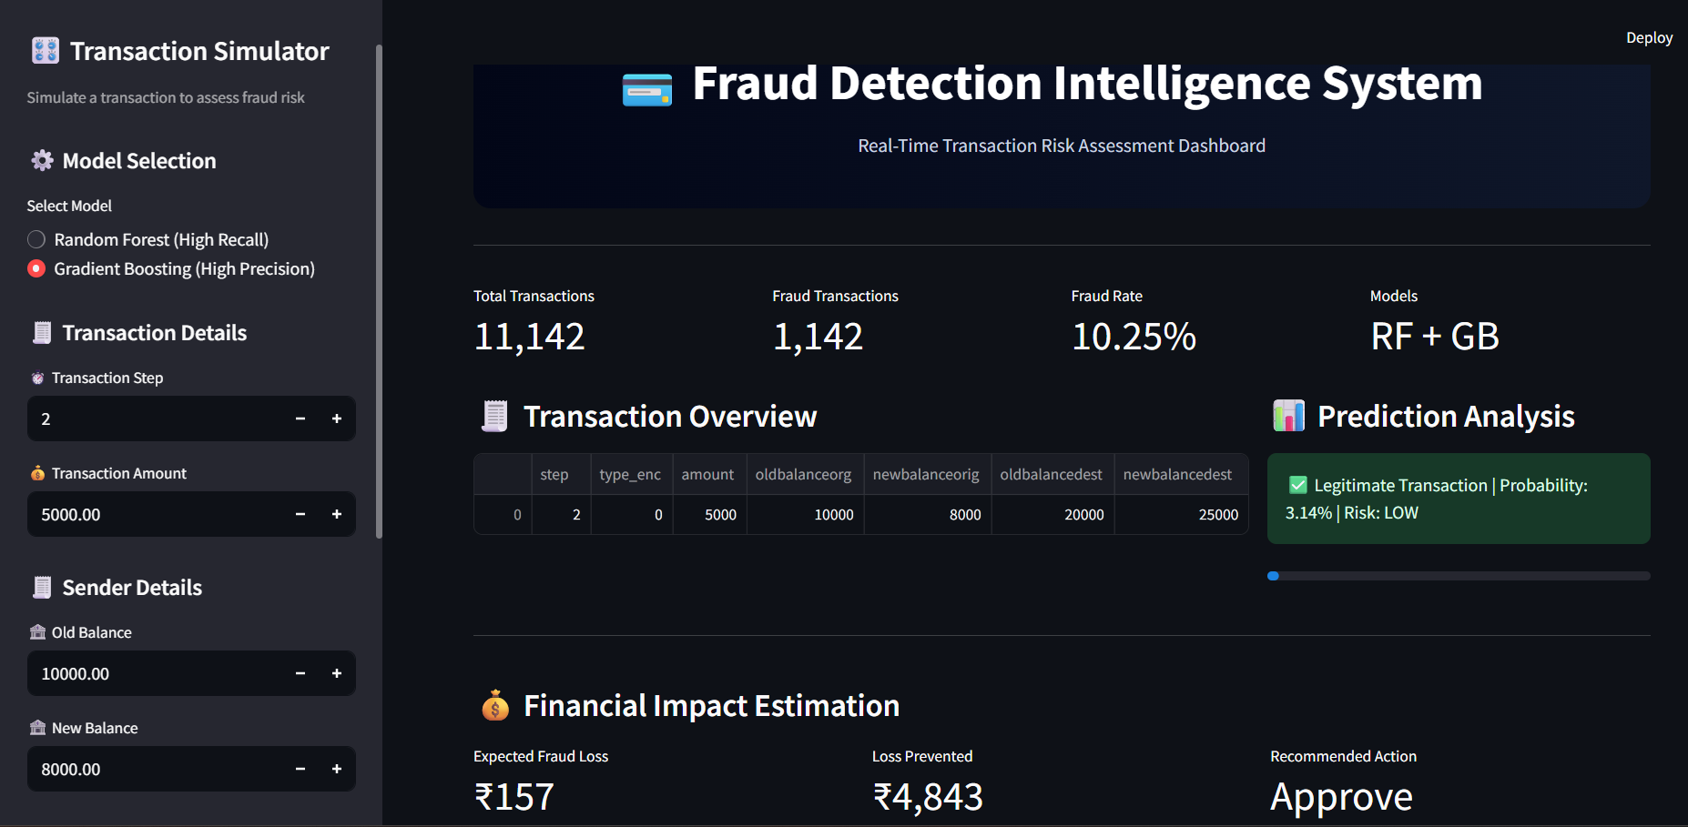

Slide 22
Transaction Simulation & Fraud Detection Output

Slide 23
1
User input features include transaction amount, transaction type, sender and receiver balances, and additional transaction-related attributes.
.
Inputs used to evaluate each transaction in real time.
2
Pre-trained ML models and saved preprocessing artifacts are loaded at runtime to generate predictions and fraud risk scores.
Models and preprocessing loaded dynamically for scoring.
Real-Time Fraud Detection Interface
Live predictions, risk scores, and transparent alerts
3
4
Business value includes real-time decision support, operational efficiency, and deployment readiness for integration into production systems.
Benefits for operations and production deployment.
Outputs present fraud alert messages, fraud risk scores, estimated financial impact, and model confidence for transparency.
Clear alerts and metrics to support decisions.

Slide 24
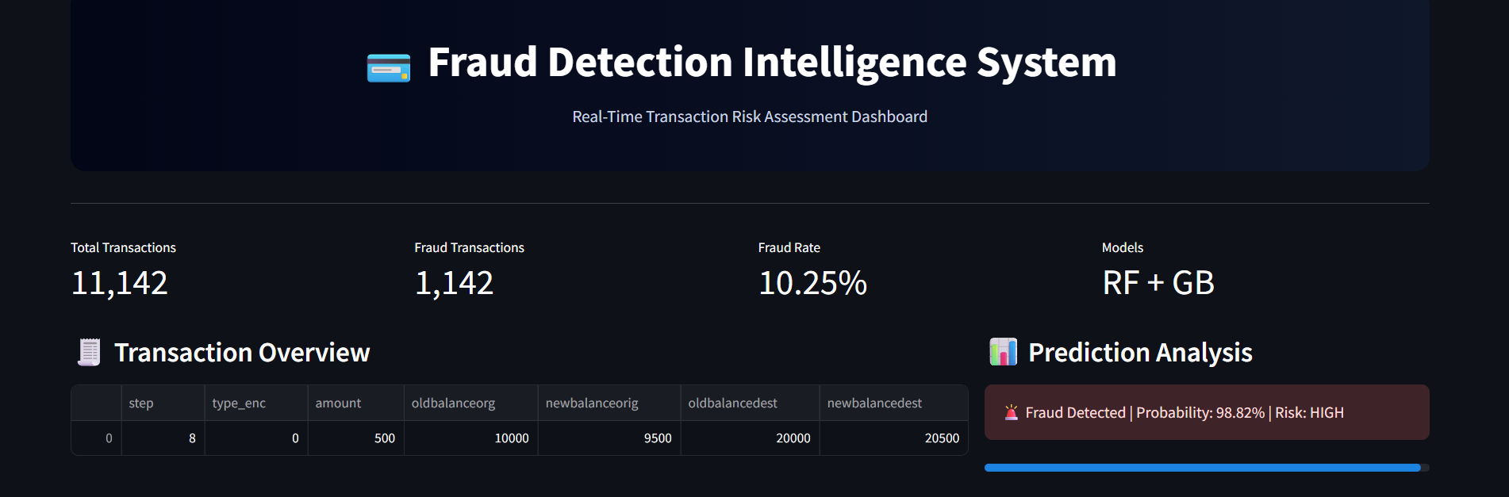
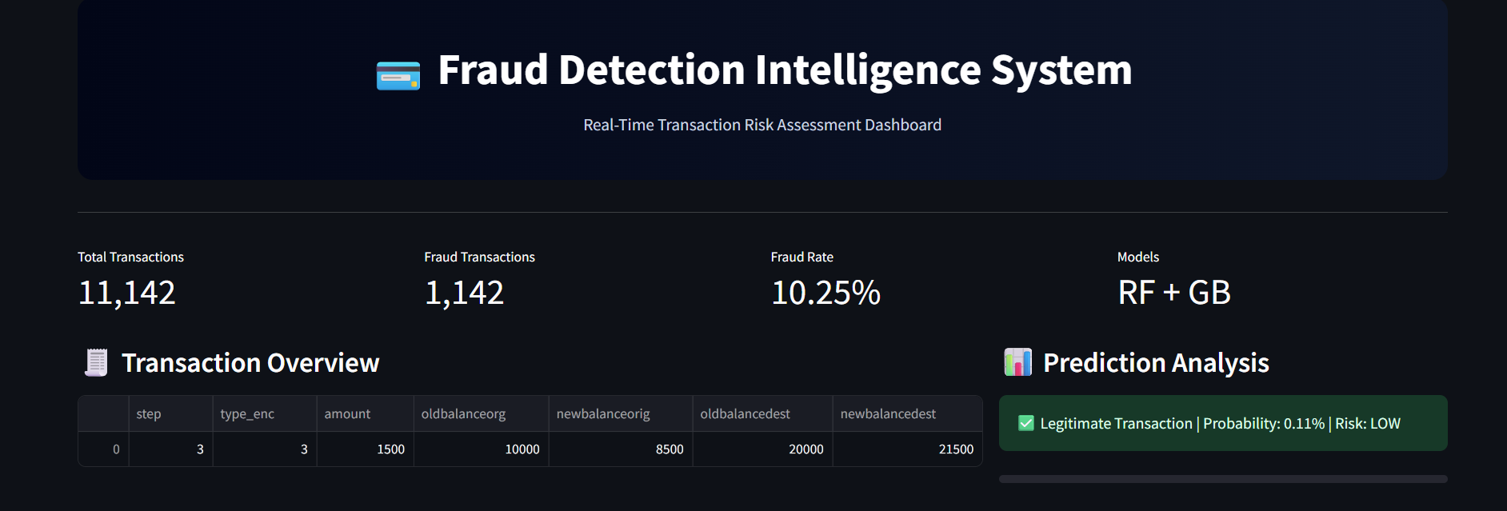
Fraud Prediction Output
Legitimate Transaction Output

Slide 25
Power BI Dashboard & Business Insights

Slide 26

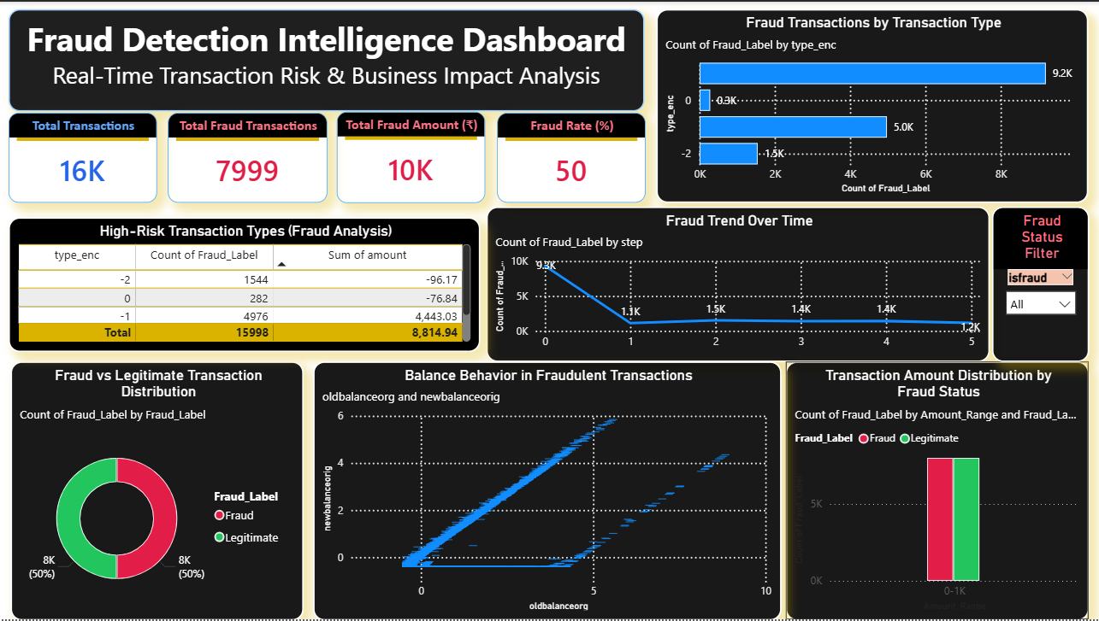
Power BI dashboards visualize fraud trends, financial impact, and operational KPIs to support informed decision-making.
Visualize trends, impacts, and KPIs for clearer decisions.
Drive Risk-Aware Decisions with Data
Power BI dashboards that turn fraud detection into measurable action

Slide 27
Financial Impact & Conclusion

Slide 28
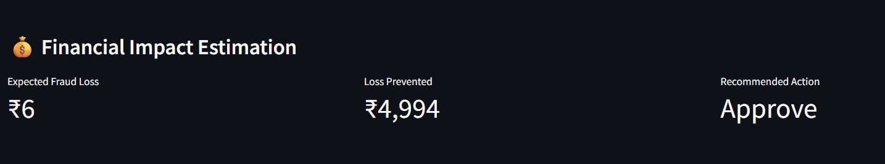
Financial Impact Analysis
The fraud detection system translates model predictions into measurable business value by estimating potential financial losses and prevention outcomes.
Calculates expected fraud loss based on detected fraud cases
Estimates loss prevented through early fraud identification
Highlights financial risk associated with missed fraud cases
This analysis helps stakeholders understand the real monetary impact of fraud detection performance.

Slide 29
Conclusion
Developed an end-to-end machine learning–based fraud detection system for mobile financial transactions
Effectively handled imbalanced data and focused on business-critical metrics
Enabled real-time fraud detection through a Streamlit application
Translated predictions into financial impact and actionable insights using Power BI
The solution improves fraud detection accuracy, reduces financial loss, and supports data-driven fraud prevention.

Slide 30
Thank You!
CONFIDENTIAL: The information in this document belongs to Boston Institute of Analytics LLC. Any unauthorized sharing of this material is prohibited and subject to legal action under breach of IP and confidentiality clauses.

